Slide 1
Data Science Space Evolution
Chad Thome
5 May 2024

Slide 2

Outline
Executive Summary
Introduction
Methods
Results
Conclusion
Appendix

Slide 3
Executive Summary
Methods
Results Summary
Collecting Data
Evolving Data
Visualizations
Python Folium Maps
Plotly Dashboards
Python Pandas - Create Data Frames
Python Numpy - Create Arrays and Insights
Precision Data Analysis
Pandas Data Frames
Screenshots, Interactive Maps
Predictions
Verification of Results

Slide 4
SpaceX Introduction
Background and Context
Questions to Answer
The company was founded in 2002 to revolutionize space technology. There are currently 341 successful launches.
The vision is to inhabit multiple planets.
Falcon 9 was created and is the Worlds First orbital class Reusable Rocket
Will Payload Mass, Launch Sites and Specific Orbits affect the mission success?
Does span of time make a difference in success?
What proof can be shown to support these ideas?

Slide 5
Methods
Data Collection
Data Evolving
Webscraping - Gathers Data from the Web
Rest API’s - Collects SpaceX Data
Get URL’s - Gathers Data from a URL
Python Pandas - Creates Data Frames
Python Numpy - Creates Arrays and Insights
Create Data Frames to focus on precise data
Replace Missing Values
Python Pandas - Create Data Frames
Create Classification Models
Classify Data as Binary
Test for Accuracy
Use Plotly, Folium, Matplot, Seaborn, R for Visualizations

Slide 6
Data Collection
This is a process that scrapes web data from a URL and uses API requests to acquire data.
These are normalized with JSON requests and converted to a Data Frame for Precision Anlaysis.
The data is tested thoroughly and modeled for accuracy checking.
API Data Frames info used: Latitude, Longitude, Launch Site, Payload, Successful or Not & Orbit
Webscraping Data Frames info used: Latitude, Longitude, Launch Site, Payload, Successful or Not & Orbit

Slide 7
Data Collection - SpaceX API
Get Data from SpaceX and decode the response with .JSON normalize function
Apply functions to format the data into a dictionary
Filter not needed data for precision
Replace NaN Null or Missing Values with .mean()
Check for Accuracy and export to CSV file
Github URL Link

Slide 8
Data Collection - Web Scraping
Get Falocn 9 Launch Data from URL
Use Beautiful Soup on the response
Take data, create dictionary and put into columns
Replace NaN Null or Missing Values with .mean()
Check for Accuracy and export to CSV file
GitHub URL Link

Slide 9
Data Wrangling
Analyze & determine training and testing data
Find the number of orbits and launches
Successful or Not with each occurence
Split into Train and Testing Sets and model
Check for Accuracy and export to CSV file
Metrics were compared to see if Launch Sites and actual Landing Sites were within the accepted ranges.
These determine if the mission was a success or it failed
Github URL Link

Slide 10
EDA with Data Visualization
Charts Plotted:
Flight Number vs Payload Mass, Flight Number vs Launch Site, Payload Mass vs Launch Site, Orbit Type vs Success Rate, Flight Number vs Orbit Type, Payload vs Orbit Type and Annual Success Rate
Charts Used Reasoning:
Line - shows trends that can be seen over time
Bar - compares 2 specific variables for key analysis
Scatter - Compares to find if relations are present and can be used in Logistic Regression Models or Machine Learning
Github URL link

Slide 11
EDA with SQL
Ranking prioritization between year, month, date, ranges
Names of successful boosters that had 4000 - 6000 range
Drone failed landing outcomes filtered to the year 2015
Unique Launch Site Names
Located records beginning with string or unknown values
Github URL link

Slide 12
Folium Interactive Map
Adding markers to world map:
Displayed circles, labels that popup, or show text label when the mouse is hovering over it. All of these use latitude and longitude coords.
Launch site Successful or Failure different colored markers:
Show using colors which missions were successful or not and where they were on a world map
Distance marked lines:
Created launch to landing site distance markers to show proximity of success or failure.
Github URL Link

Slide 13
Build a Dash Board with Plotly Dash
Clear the layout and create a data frame
Extract Year and month from the date
Creat app layout
Add radio buttons, drop down menus
Callback Function, plotting
Drop Down - Site Selection
Slider - Payload Ranges
Pie Chart - Compare Total Successful Launches
Scatter Chart - compared successful launches to payloads carried
Github URL

Slide 14
Predicitve Analysis (Classification)
Numpy array - class column
Standardize data
Train and test sets
Using selected data
KNN, Log Reg and Tree Models
Find out accuracy
Confusion matrix
Jaccard and F1 scores
Analyze & determine training and testing data
Find the number of orbits and launches
Successful or Not with each occurence
Split into Train and Testing Sets and model
Check for Accuracy and export to CSV file
Github URL

Slide 15
Results
Exploratory data analysis results
Interactive analytics demo in screenshots
Predictive analysis results

Slide 16
Section 2
Insights drawn from Exploratory Data Analysis

Slide 17
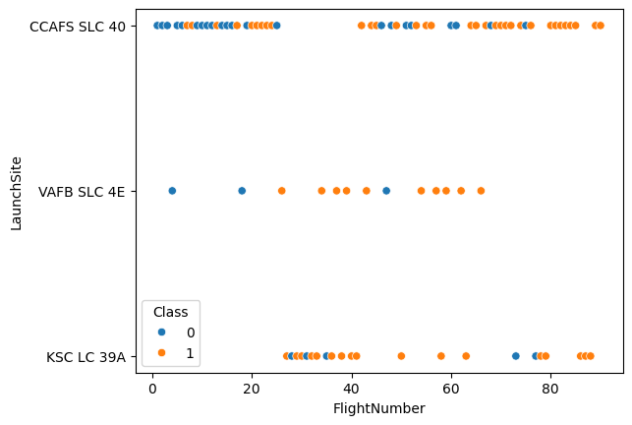
Flight Number vs. Launch Site
With every new launch, the success rates increased
VAFB had the most success
The first launches werent always successful, but some were planned that wayyy
SLC 40 totaled nearly half the launches

Slide 18
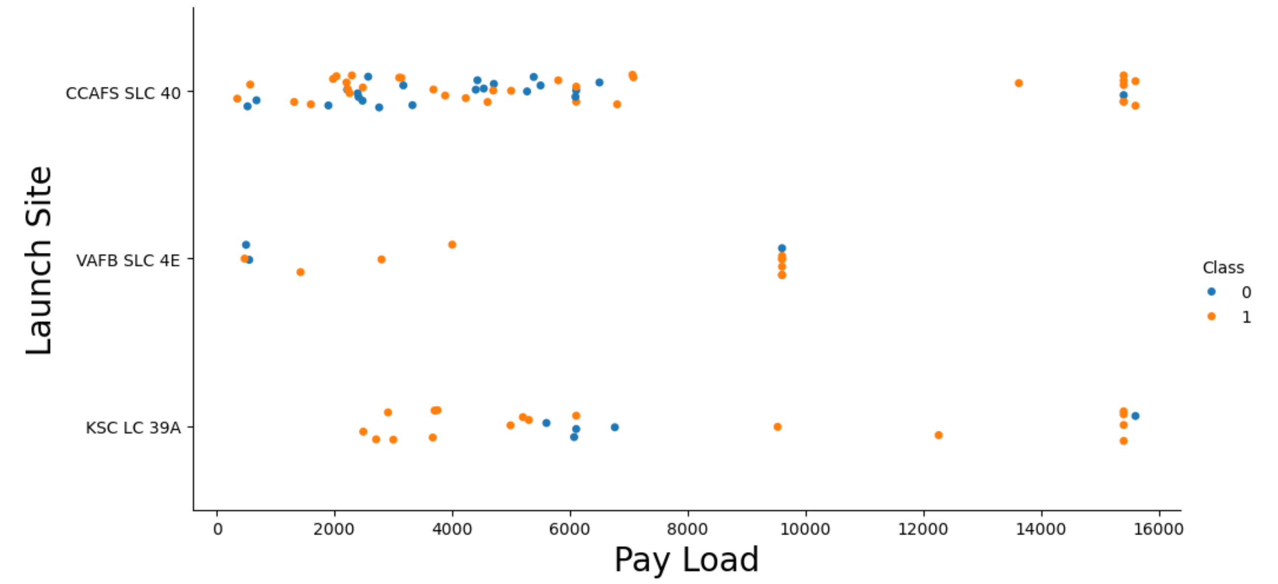
Payload vs. Launch Site
Class 0 is Failed Launches
Class 1 is Successful Launches
The greater Pay Load Mass equaled more success
CCAFS SLC 40 achieved 60% launch success
VAFB SLC 4E achieved 77% launch success
KSC LC 39A achieved 77% launch success

Slide 19
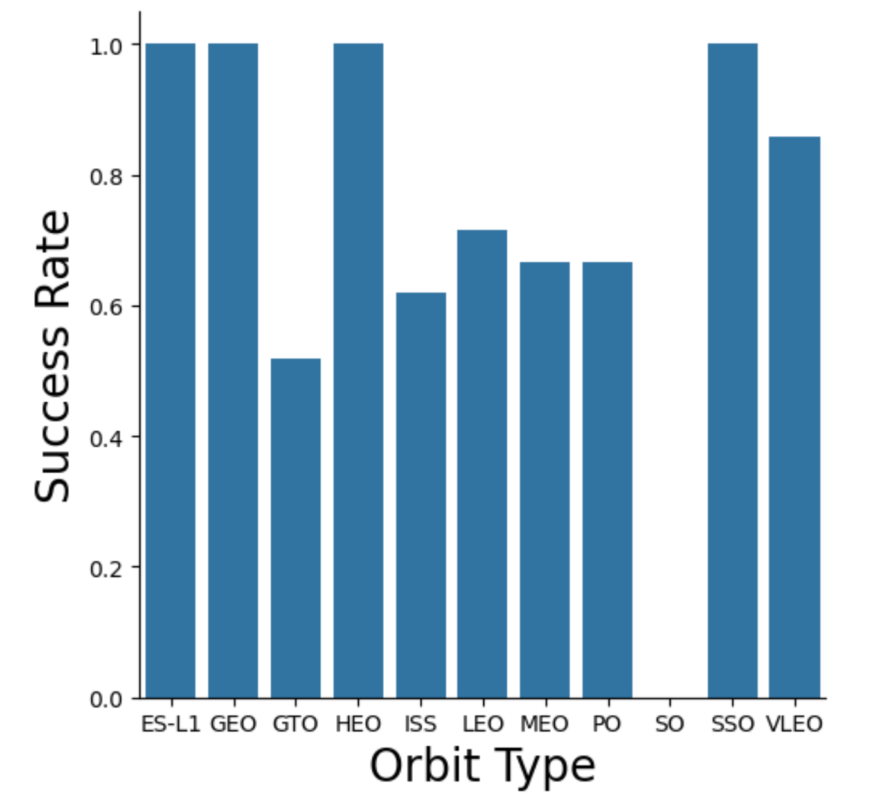
Success Rate vs. Orbit Type
Orbits with 0% success rate - SO
Orbits with 50% - 70% success rates - GTO, ISS, LEO, MEO & PO
Orbits with 100% success rates - ES-L1, GEO, HEO & SSO

Slide 20
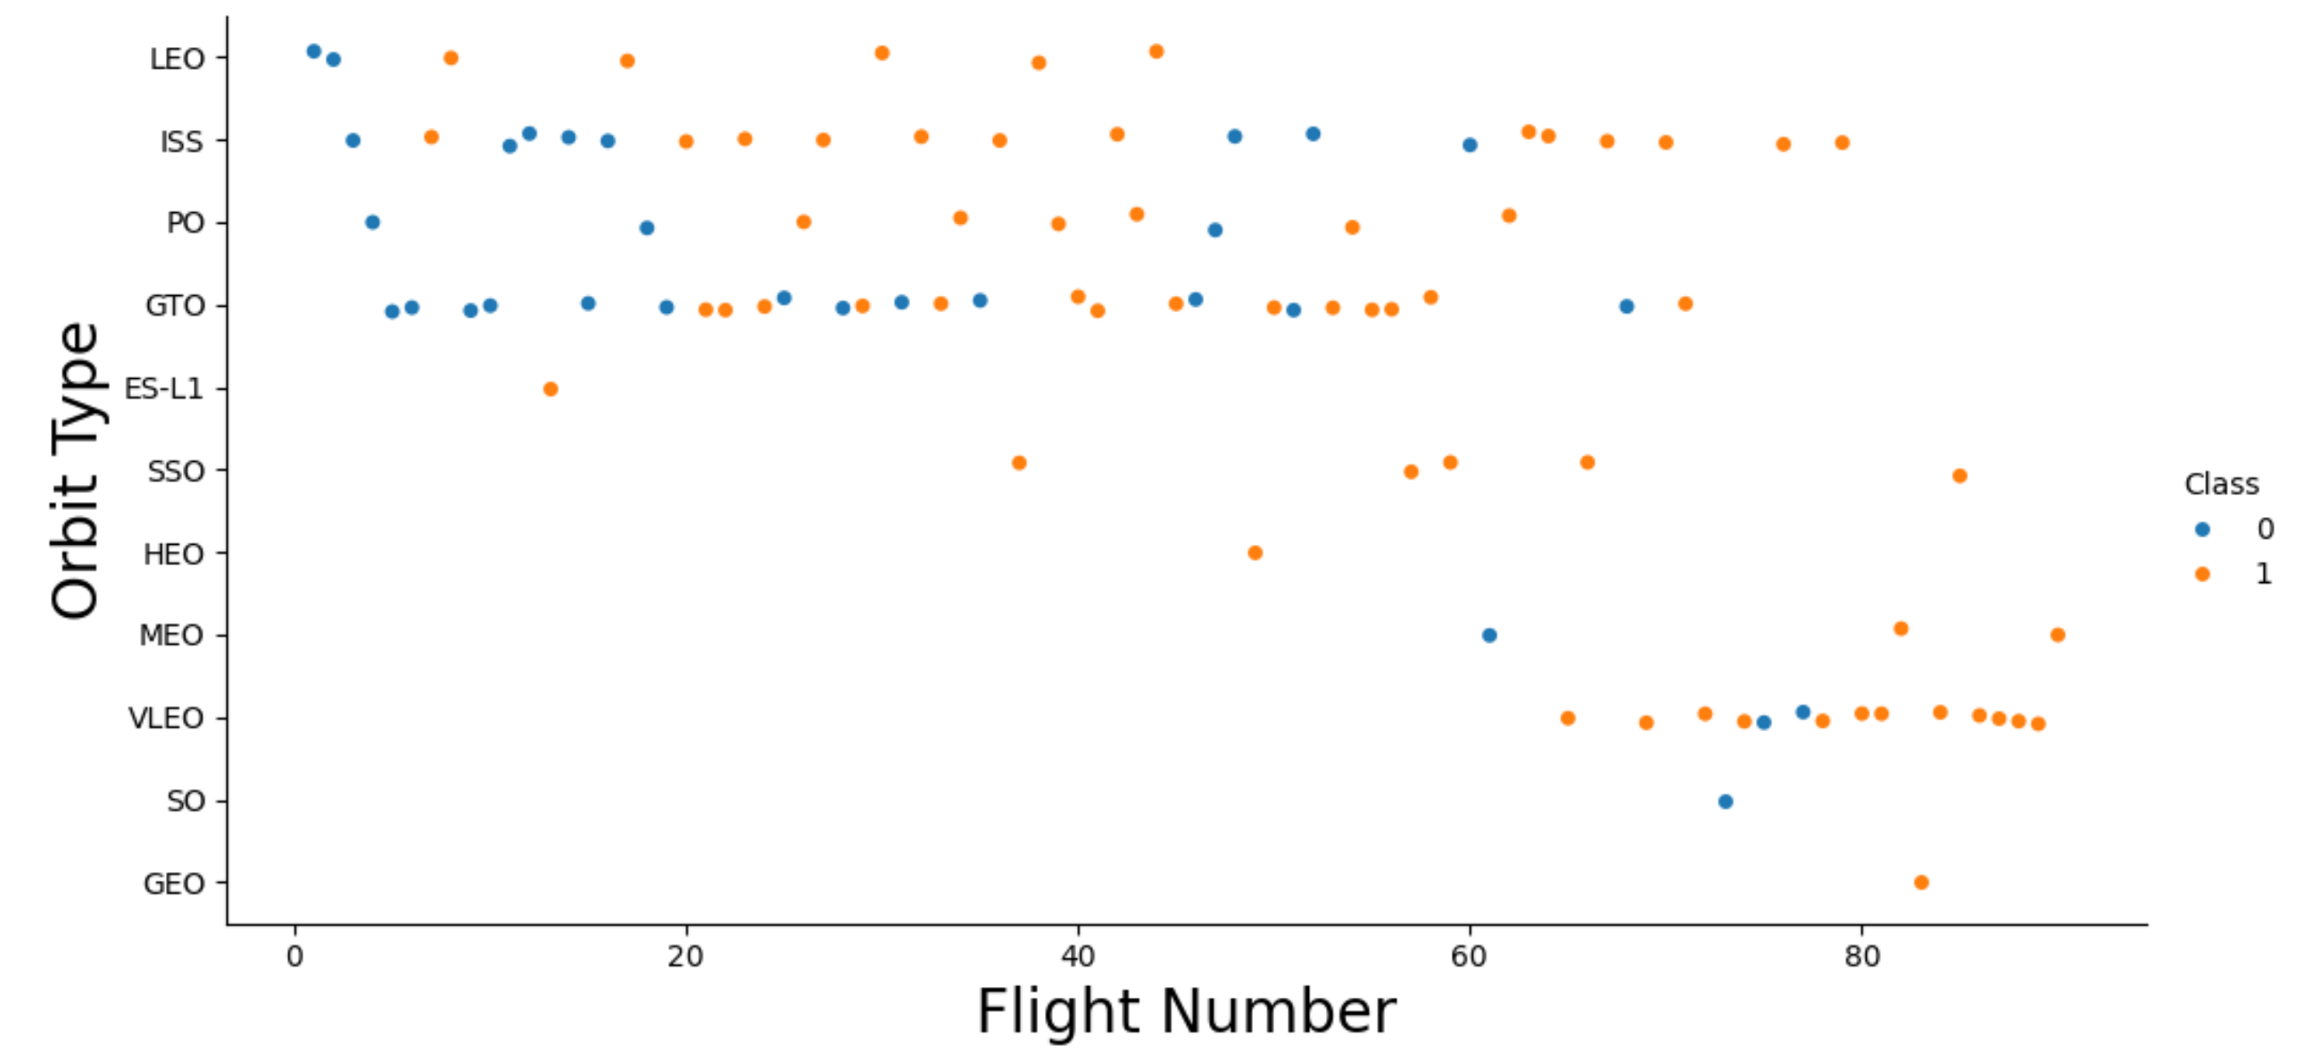
Flight Number vs. Orbit Type
The number of flights appears unrelated to the typpe of orbit
VLEO appears to have a relation with the number of flights

Slide 21
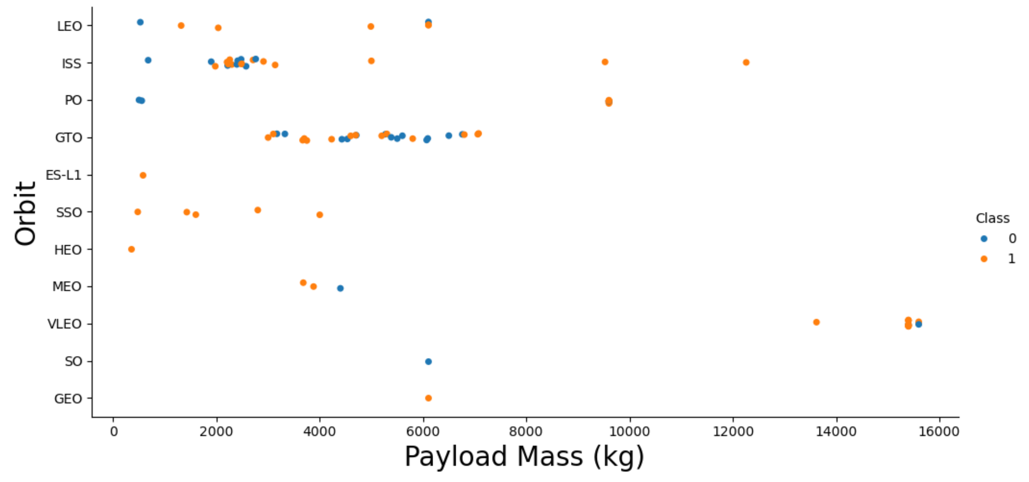
Payload vs. Orbit Type
Payloads under 7000 (kg) seem to have a positive impact on ISS & GTO Orbits
Payloads above 8000 (kg) seem to have a negative impact on Orbit

Slide 22
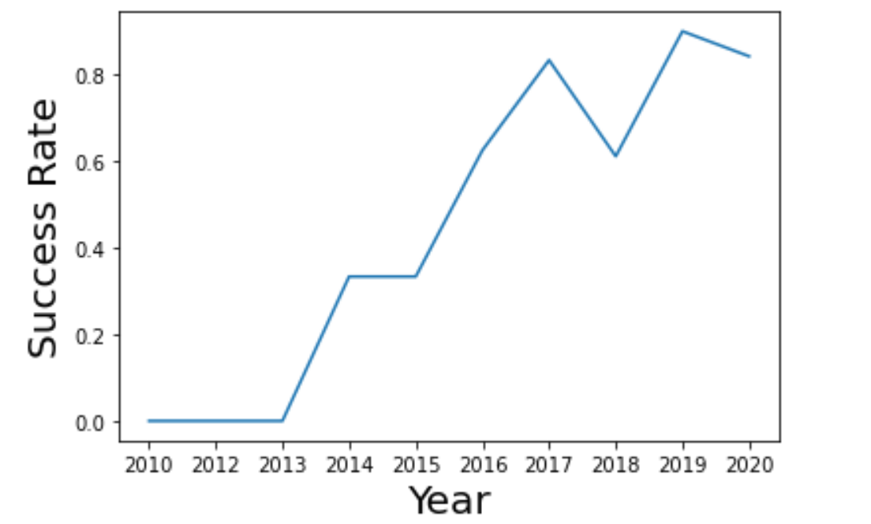
Annual Launch Success
2010 - 2013 had 0% success rates
2013 - 2015 had 0% - 35% success rates
2015 - 2017 had 35% - 80% success rates
2017 - 2020 had 65% - 90% success rates

Slide 23
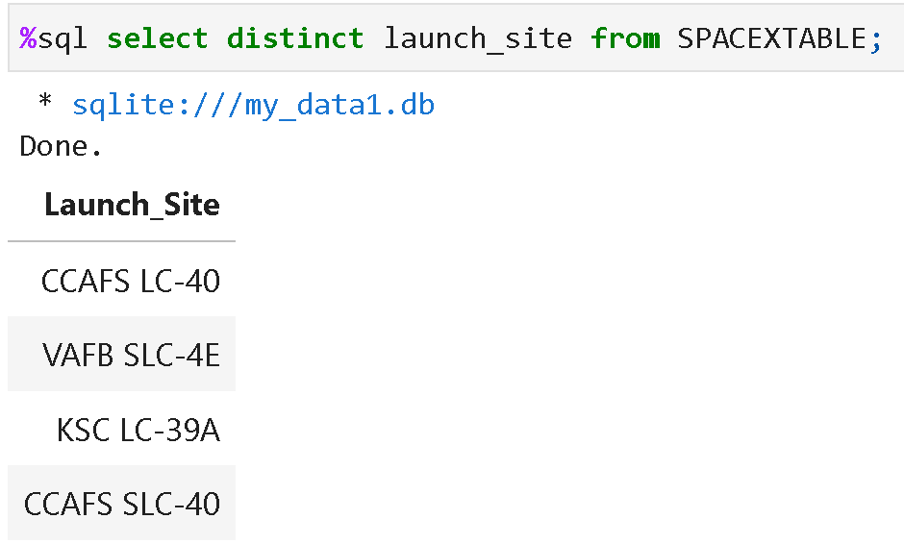
Unique Launch Site Names
Showing the unique (no doubles) Launch Sites

Slide 24
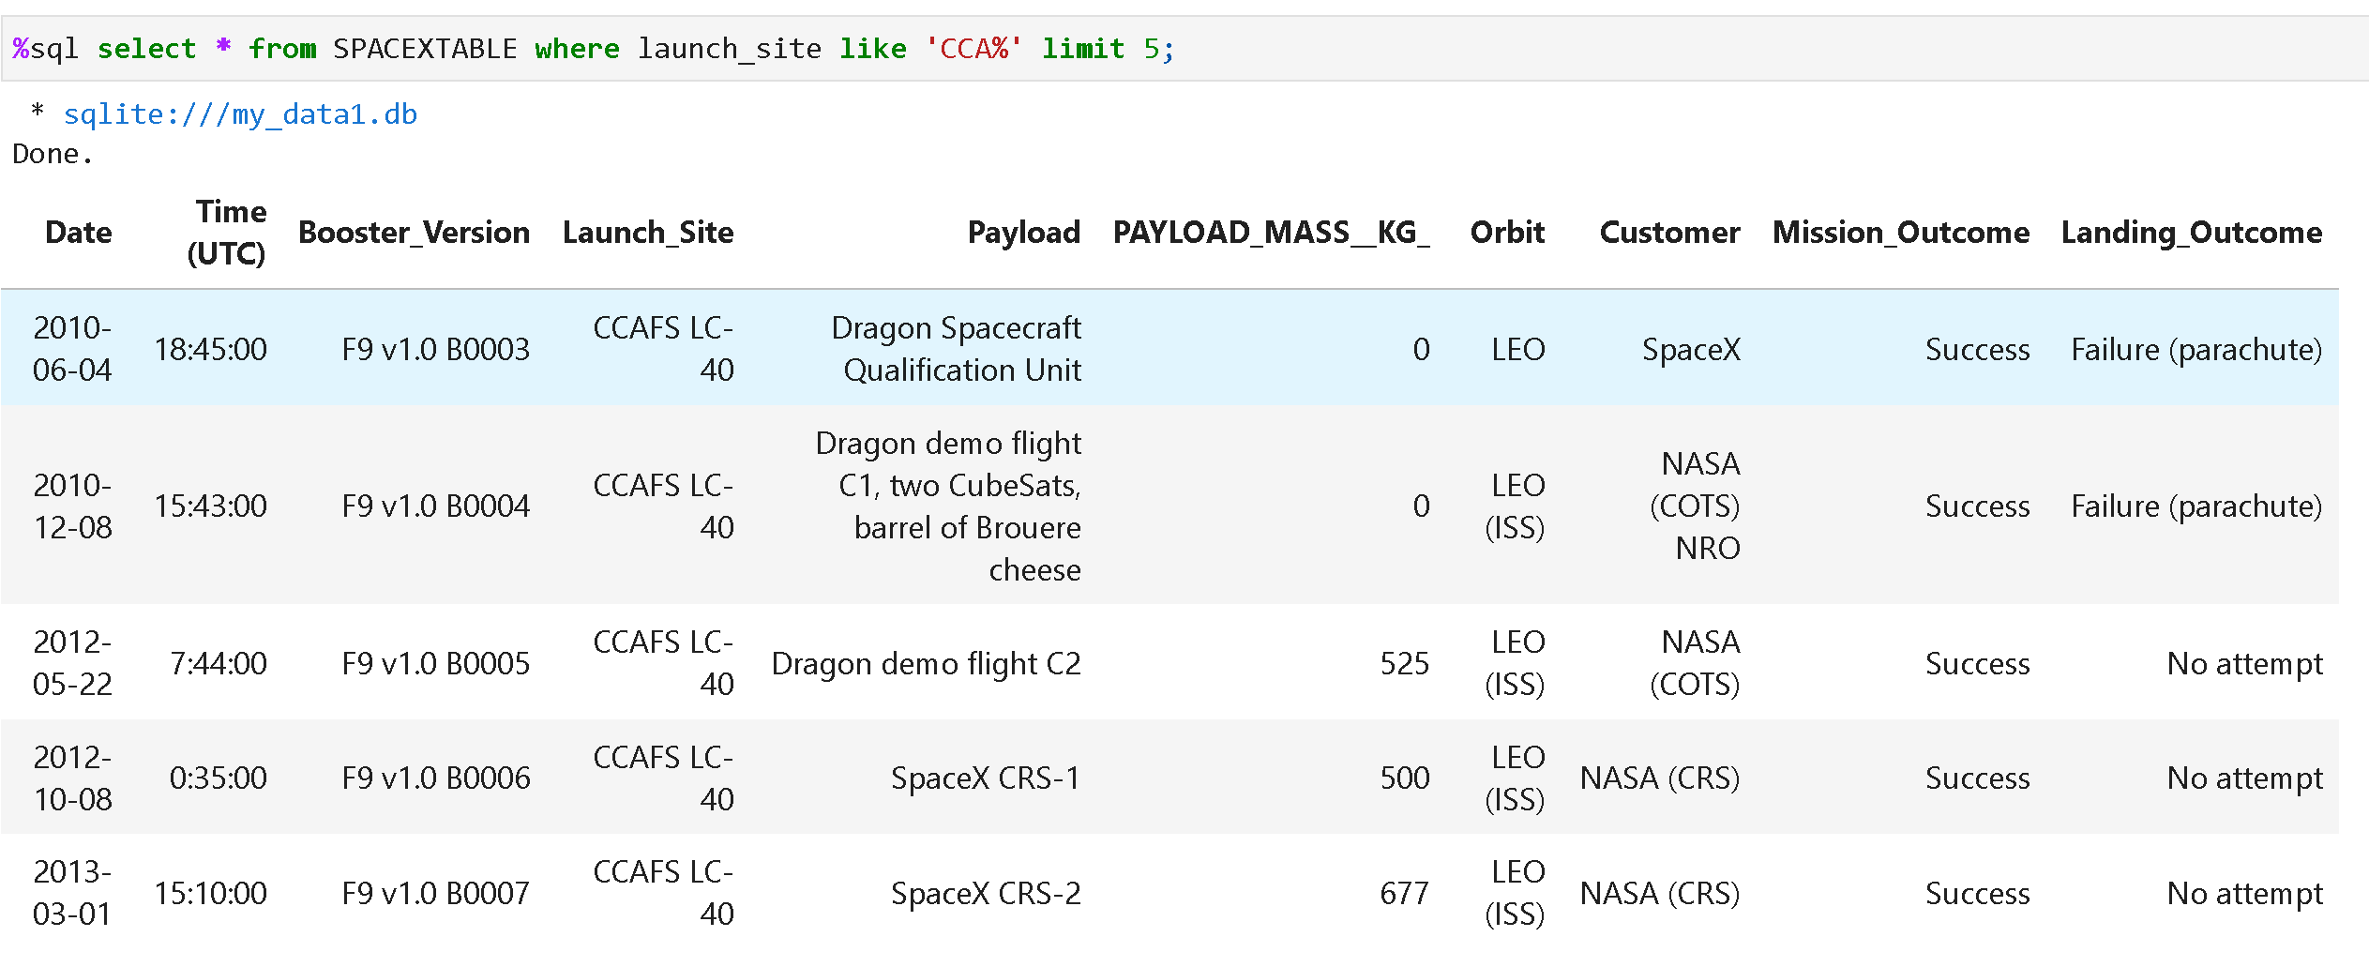
Launch Site Names that Begin with CCA
Showing the unique (no doubles) Launch Sites

Slide 25
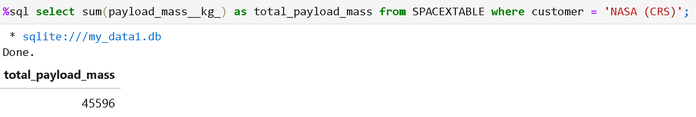
Total Boosters Payload Mass
Showing the Total Payload Mass of all booster rocket styles

Slide 26
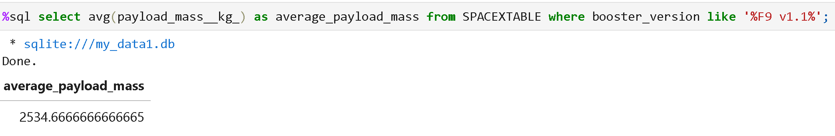
Average Falcon 9 Payload Mass
Showing the Average Payload Mass of Falcon 9

Slide 27
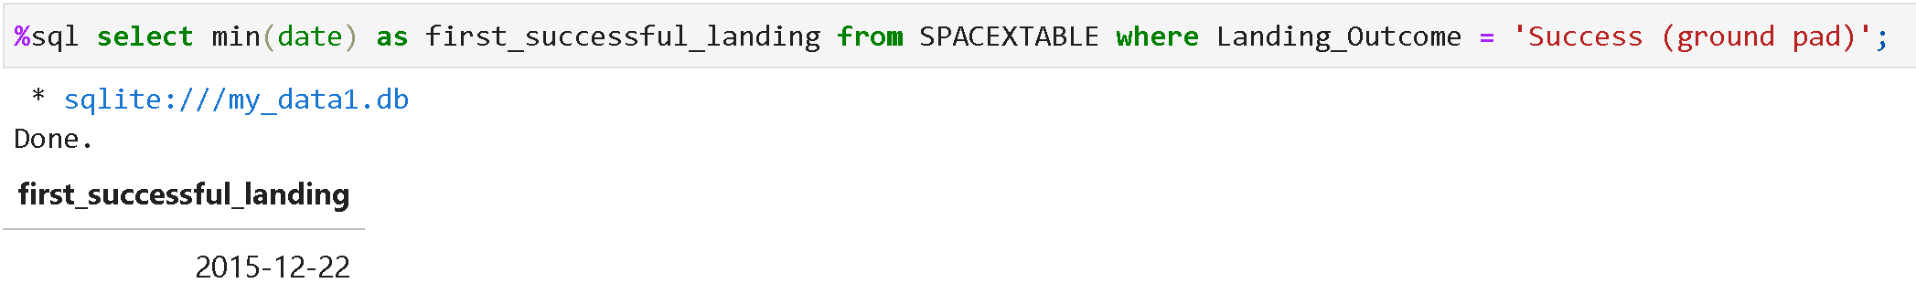
First Successful Landing Date
Showing the first date that a successful landing occured

Slide 28
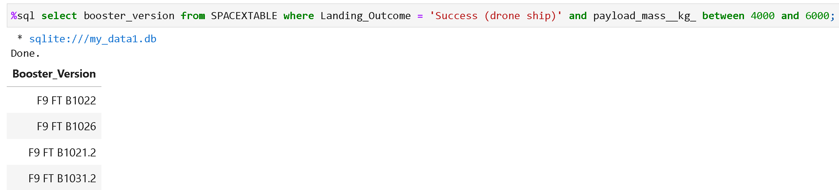
Succcessful Drone Ship Landing
Showing the successful drone ship landing with a payload mass between 4000 - 6000 (kg)

Slide 29
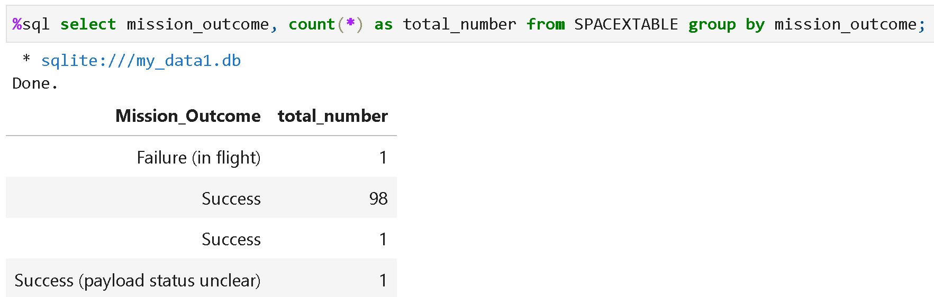
Success or Failed Missions
Showing the total numbers of successful or failed missions

Slide 30
Booster Versions
Showing Booster Versions that carried a Max Payload Mass

Slide 31
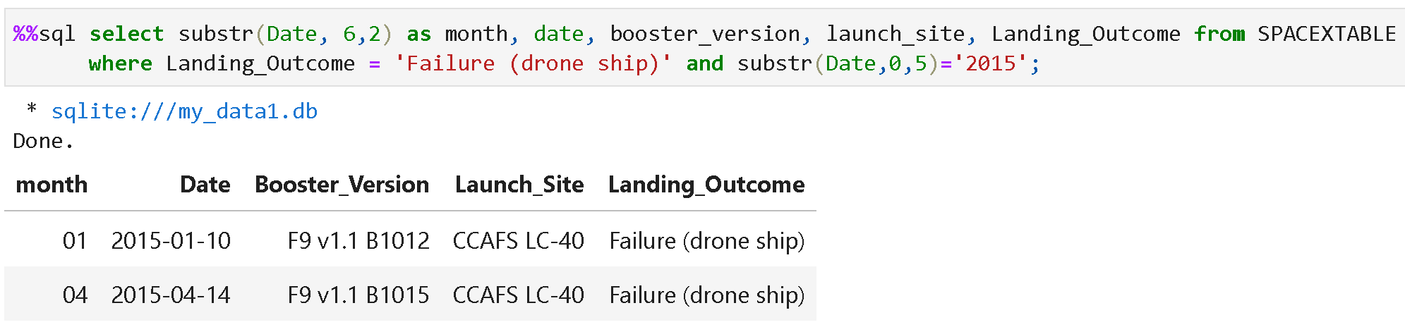
Launch Records
Showing Month, Date, Booster Versions, Launch Sites and Landing Outcomes

Slide 32
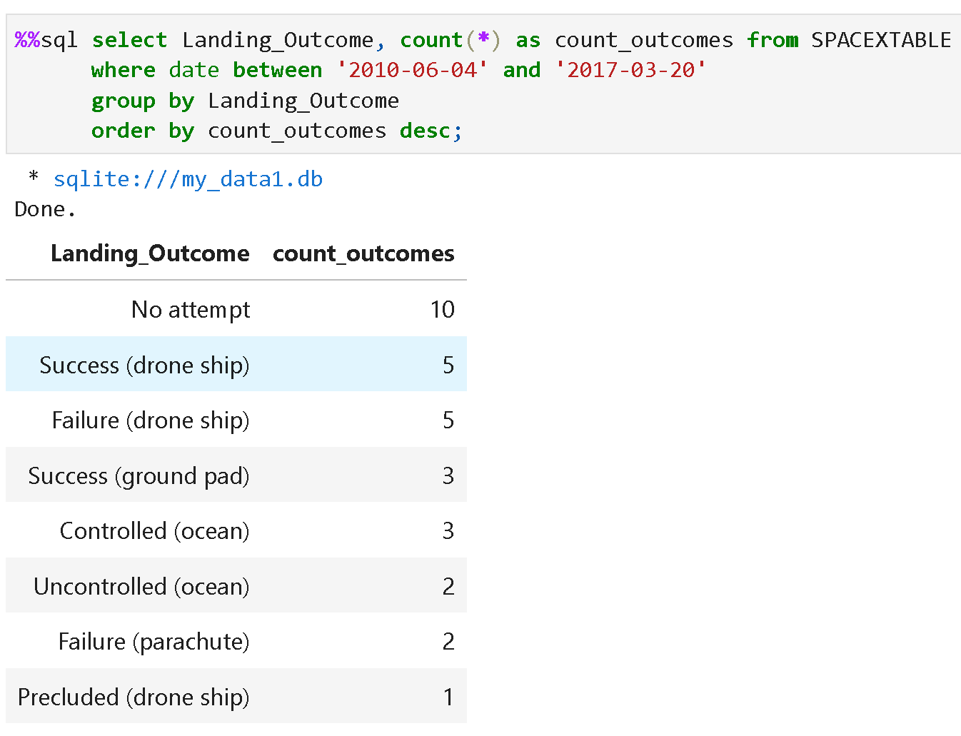
Ranking Launch Outcomes
Showing Landing Attempts Outcomes between 4 June 2010 - 20 March 2017

Slide 33
Section 3
Launch Sites Proximity Analysis

Slide 34
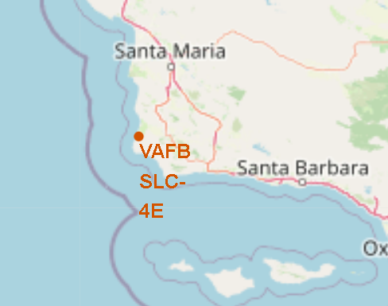
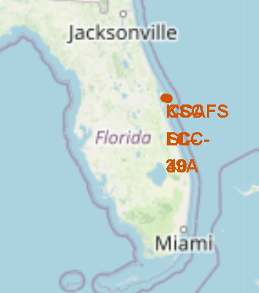
SpaceX Launch Sites Map
Showing ALL Lauch Sites on a world map

Slide 35
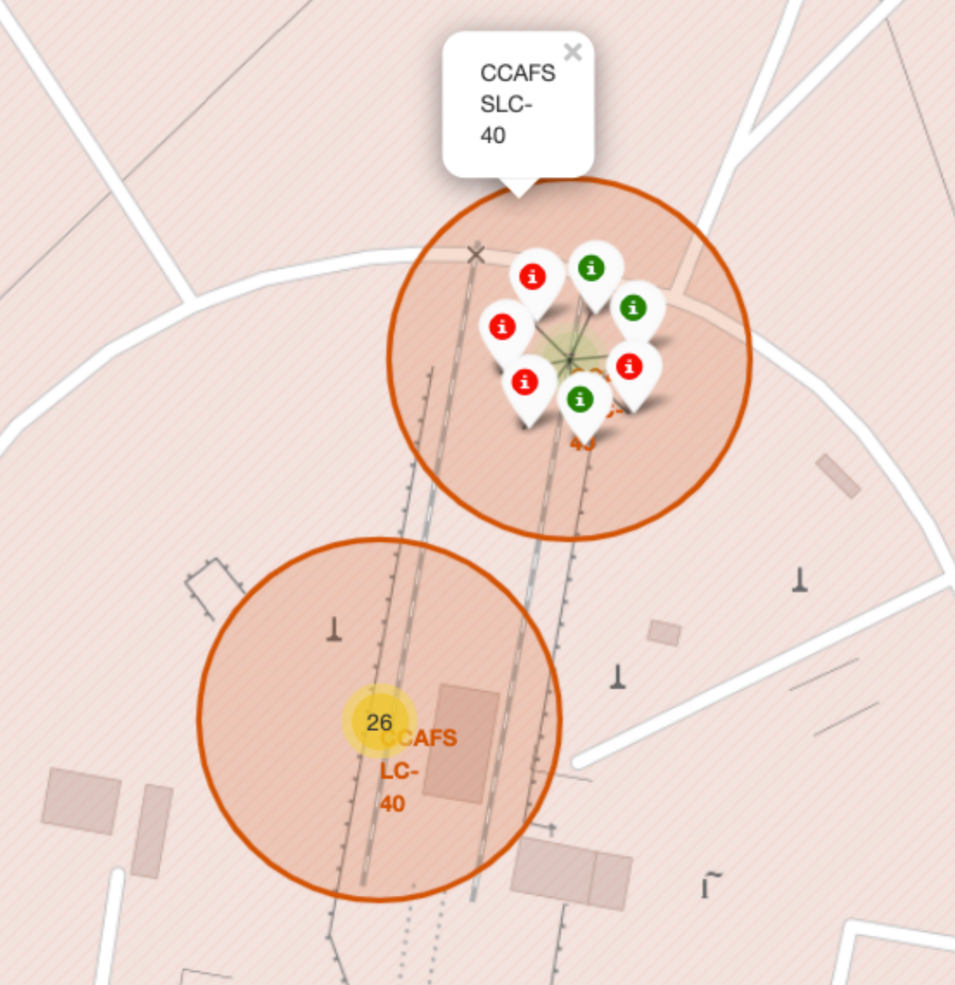
SpaceX Launch Outcomes Map
Green is successful
Red is failure
Showing Launch Sites Outcomes

Slide 36
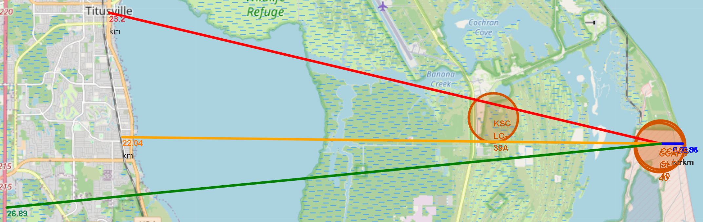
SpaceX Launch Proximities Map
Red is distance to nearest city
Yellow is distance to nearest railway
Green is distance to nearest highway

Slide 37
Section 5
Predictive Analysis (Classifcation)

Slide 38


